Slide 1
Kmeans, Decision Tree, Logistic Regression
Machine Learning in Pyspark
30th May 2019
Kuan Sao I

Slide 2
Content
Pyspark ML pkg. Vs Sk-Learn
Iris dataset
Kmeans Clustering (ML, SK)
Decision Tree(ML)
Logistic Regression(ML)
Summery
Furthermore topic
Pipeline in ML pkg.
Linear Regression
– Flight timetable
Agglomerative Custering
– Swiss roll

Slide 3
Pyspark ML pkg.
Classification | Regression | Clustering
1. Logistic Regression | 1. AFTSurvivalRegression | 1. BisectingKMeans
2. DecisionTreeClassifier | 2. DecisionTreeRegressor | 2. Kmeans
3. GBTClassifier | 3. GBTRegressor | 3. GaussianMixture
4. RandomForestClassifier | 4. GeneralizedLinearRegression | 4. LDA
5. NaiveBayes | 5. IsotonicRegression
6. MultilayerPerceptronClassifier | 6. LinearRegression
7. OneVsRest | 7. RandomForestRgressor

Slide 4
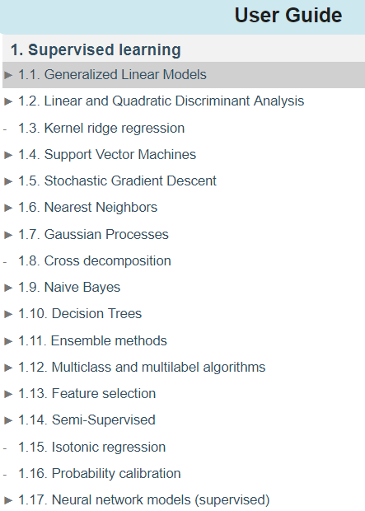
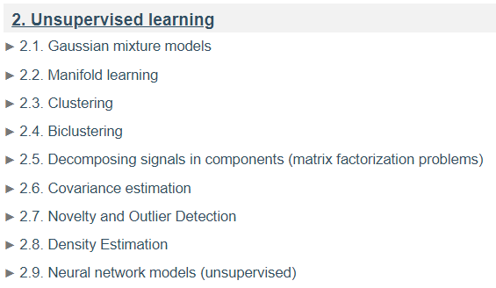
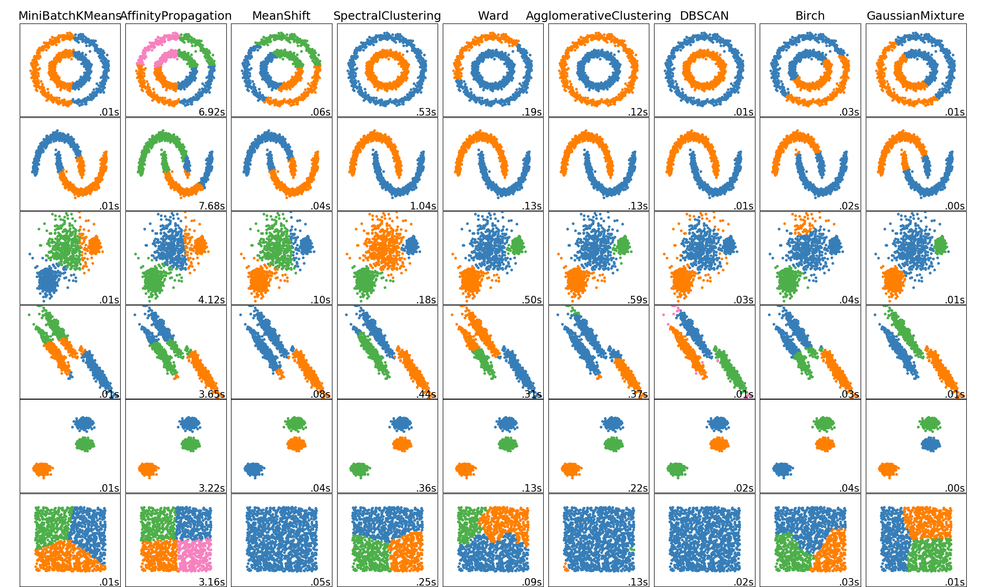
Sk-Learn

Slide 5
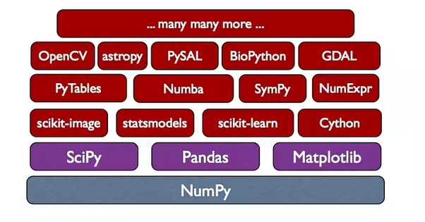
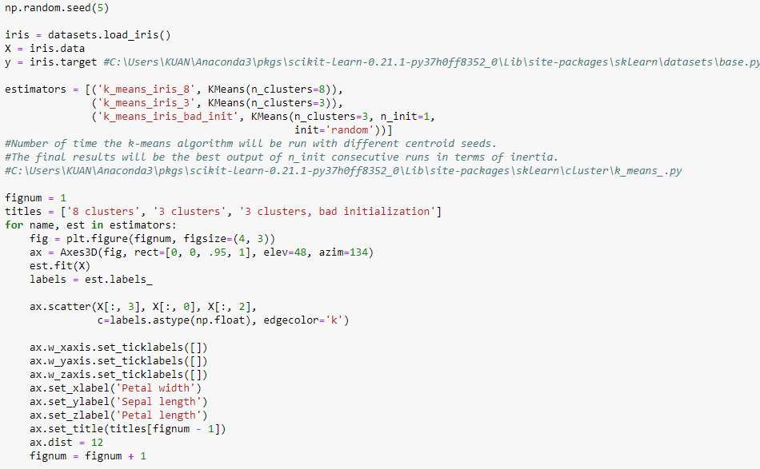
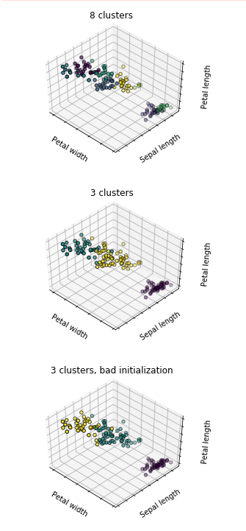
SK Learn - Kmeans Clustering

Slide 6
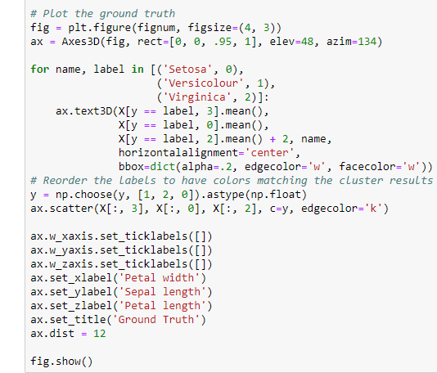
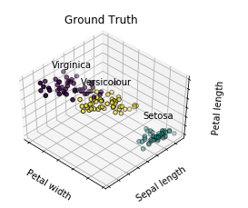
SK Learn - Kmeans Clustering

Slide 7
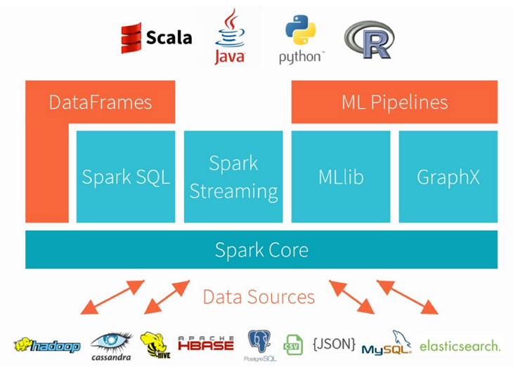
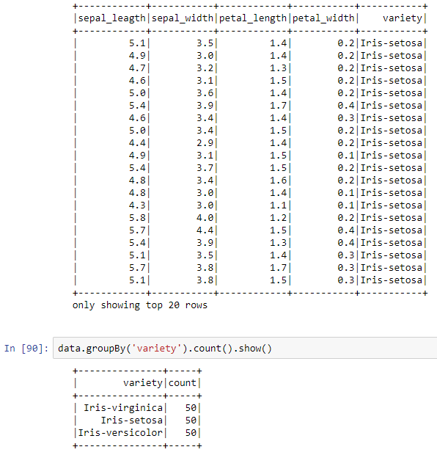
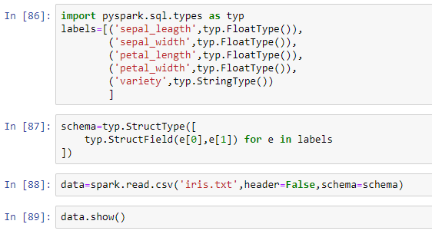
ML - Kmeans Clustering

Slide 8
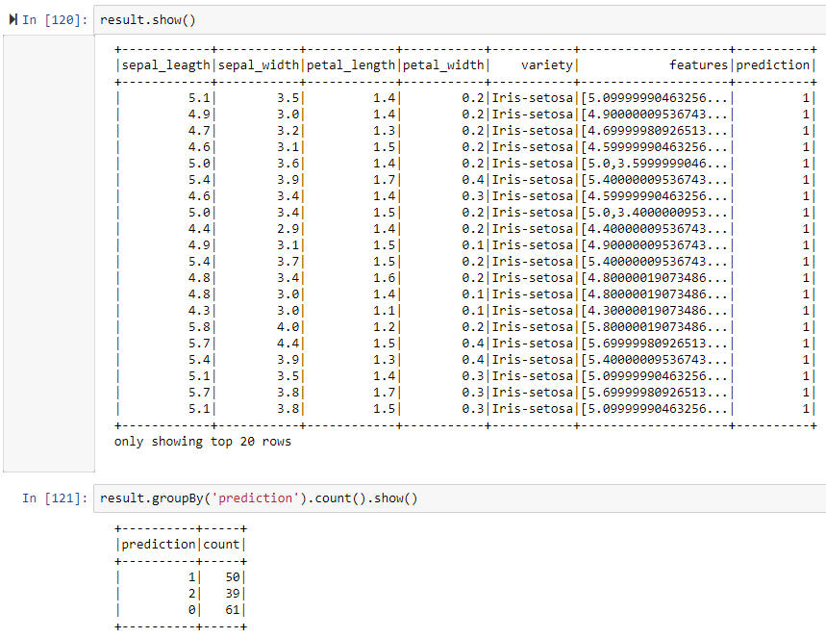
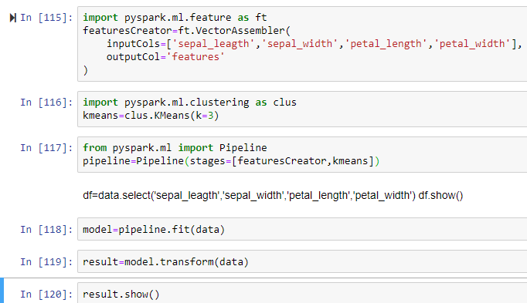
ML - Kmeans Clustering

Slide 9
Decision Tree Flow
Config and load data
Extract useful data
Cleanup Data
Make data frame
Label species
Perform data analytics
Prepare data for ML
Perform Machine Learning

Slide 10
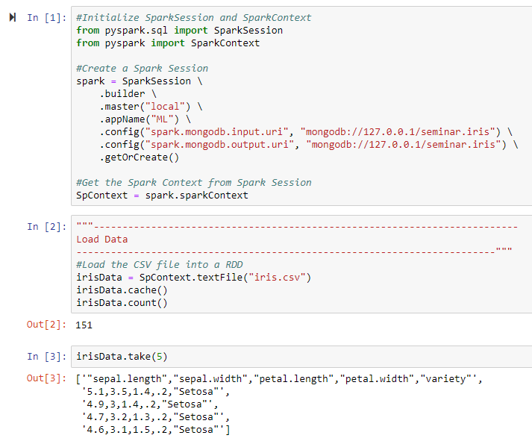
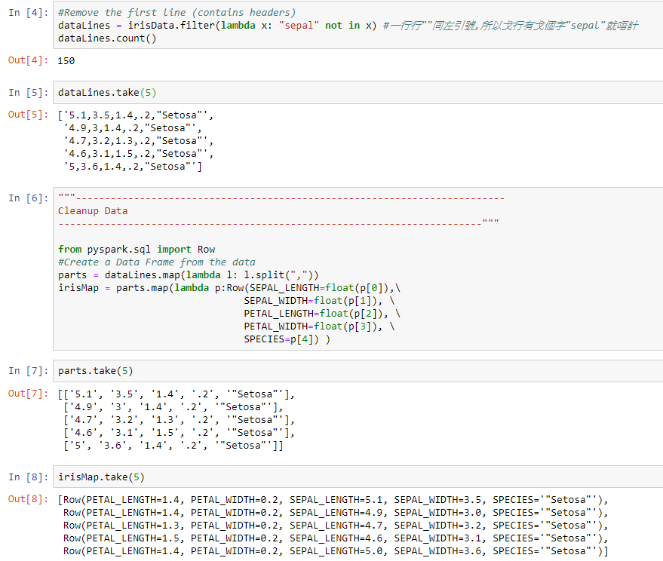
Decision Tree

Slide 11
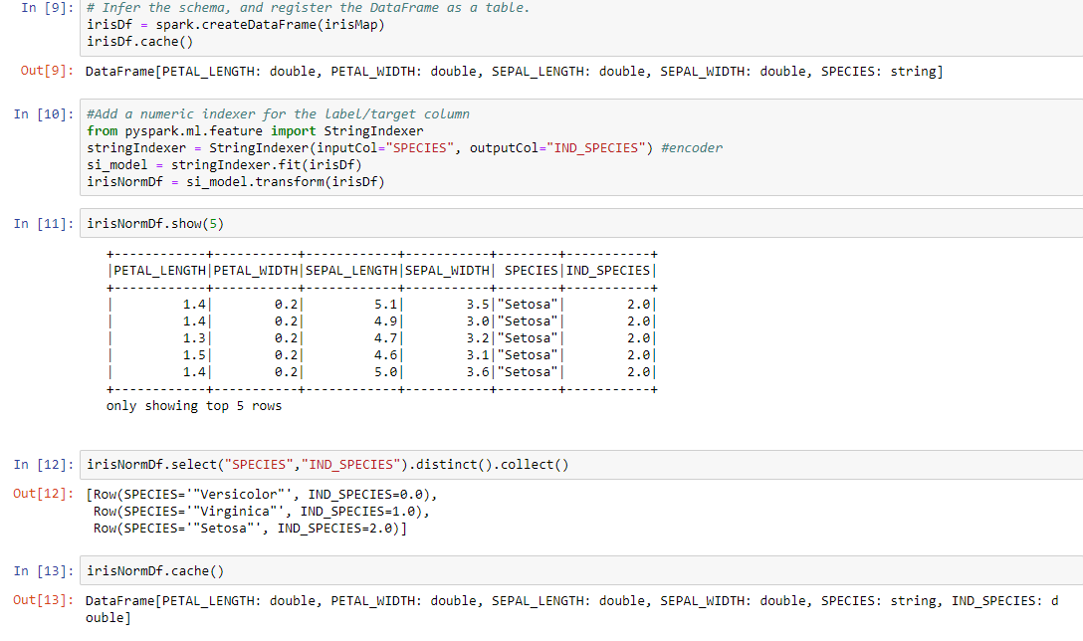
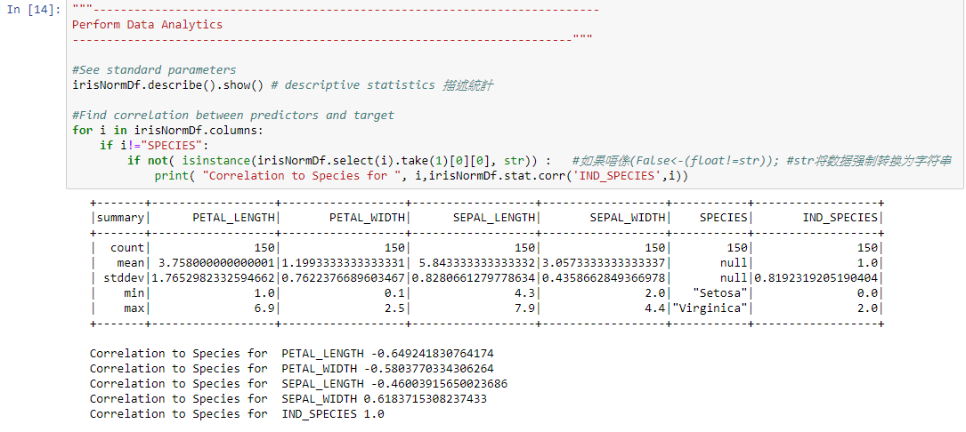
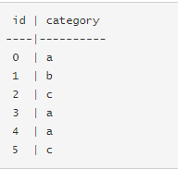
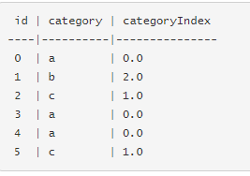
Decision Tree
StringIndexer

Slide 12
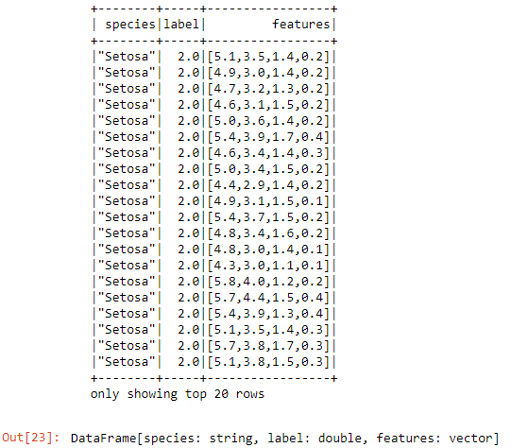
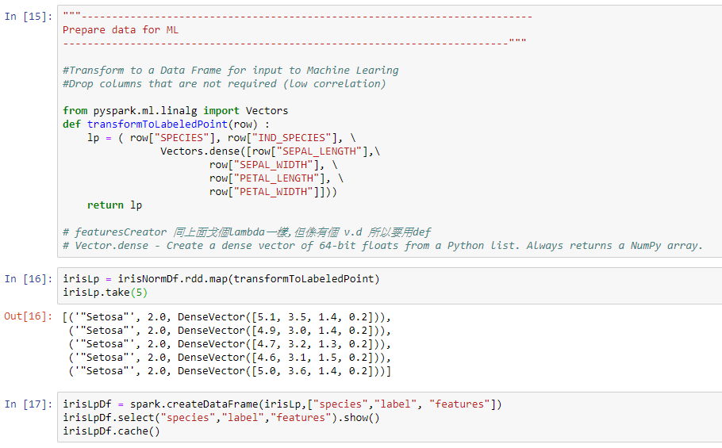
Decision Tree

Slide 13
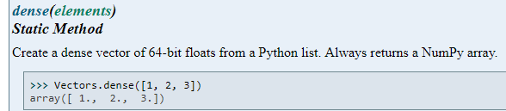

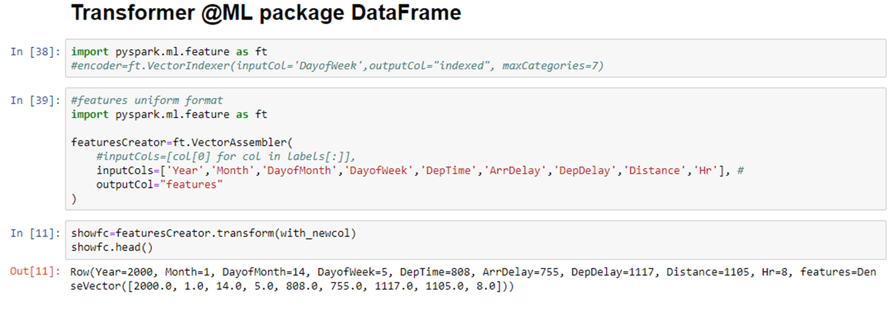
Vectors.dense

Slide 14
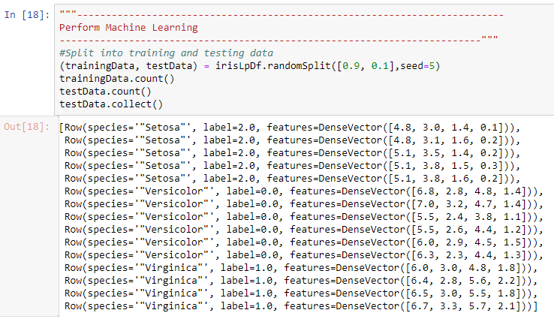
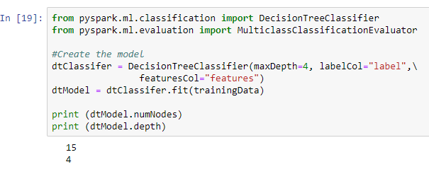
Decision Tree

Slide 15
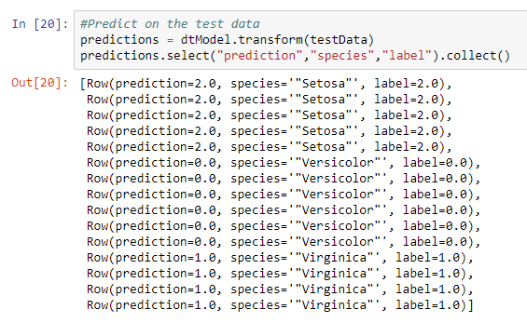
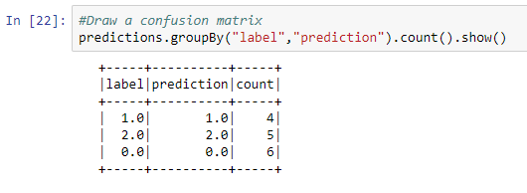
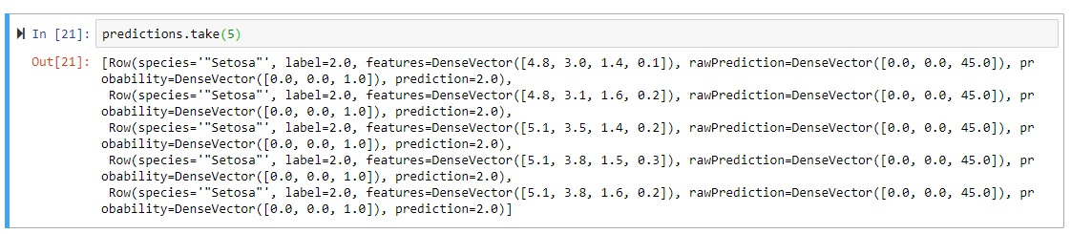
Decision Tree

Slide 16
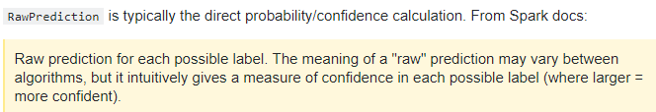
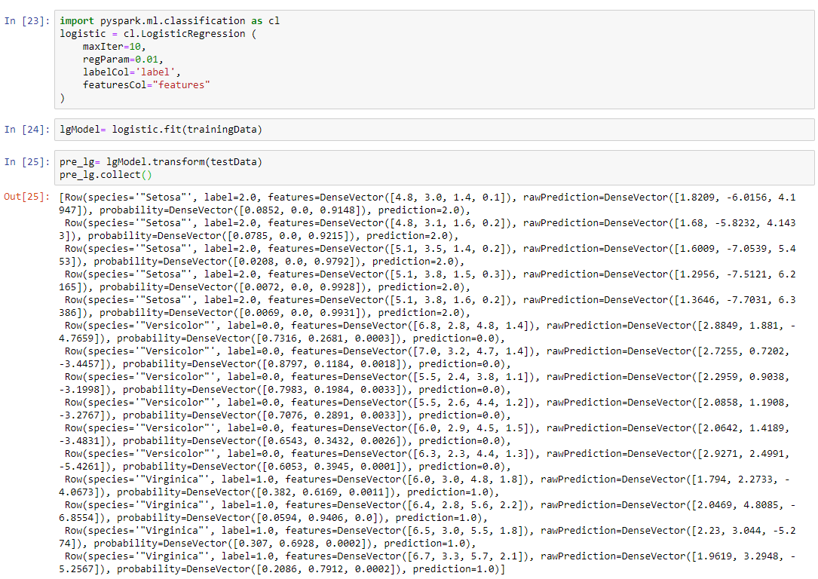
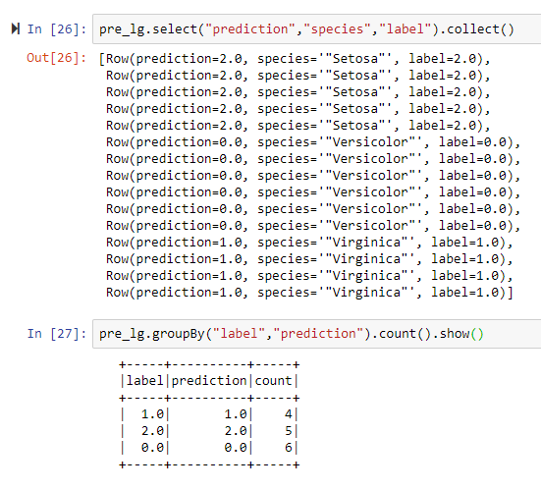
Logistic Regression

Slide 17
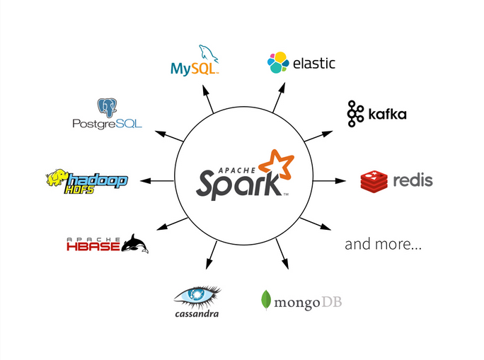
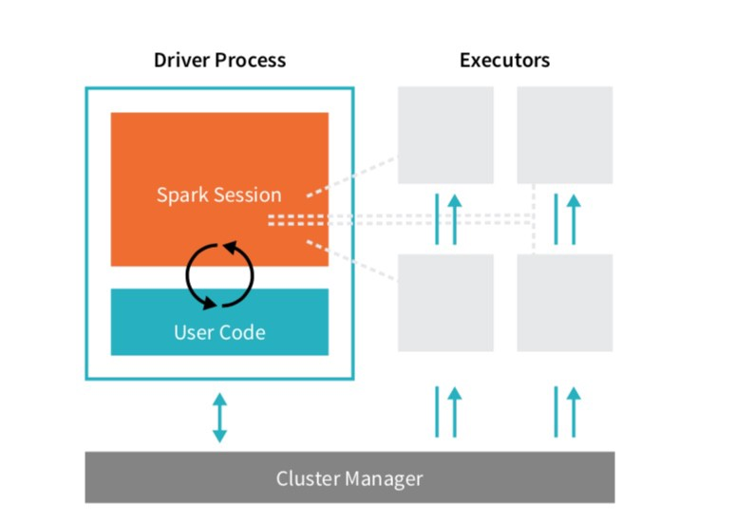
Summery
Pyspark ML pkg. Vs Sk-Learn
Iris dataset
Kmeans Clustering (ML, SK)
Decision Tree(ML)
Logistic Regression(ML)
 | SK-learn | Pyspark ML
Pros | Numpy, Pandas, Matplotlib ML learning focus TensorFlow | Apache SQL Cluster Streaming
Cons | Streaming Cluster | Plotting – databricks, matplotlib

Slide 18
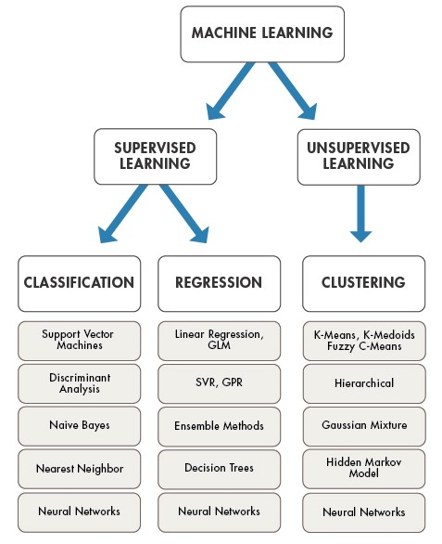
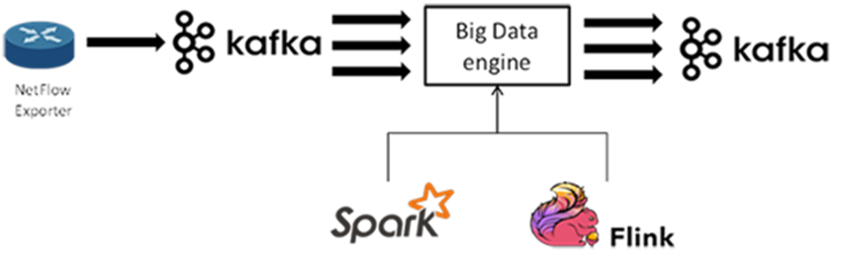
Furthermore
Streaming
Other ML Algorithm
Classification | Regression | Clustering
1. LogisticRegression | 1. AFTSurvivalRegression | 1. BisectingKMeans
2. DecisionTreeClassifier | 2. DecisionTreeRegressor | 2. Kmeans
3. GBTClassifier | 3. GBTRegressor | 3. GaussianMixture
4. RandomForestClassifier | 4. GeneralizedLinearRegression | 4. LDA
5. NaiveBayes | 5. IsotonicRegression
6. MultilayerPerceptronClassifier | 6. LinearRegression
7. OneVsRest | 7. RandomForestRgressor
Notes:
Study method:
Books & Articles
Online course & materials
Practice

Slide 19
The End ​ Thank you​ Kmeans, Decision Tree, Logistic Regression
Machine Learning in Pyspark
30th May 2019
Kuan Sao I

